Slide 1


SAP S/4HANA Training
MASTER DATA GOVERNANCE (SAP MDG)
Neeraj Gupta
Session 23
SAP MDG – Data Enrichment

Slide 2
Maintaining RFC destination FL_GDQC_SERVER for SAP DQM integration
23
SAP MDG – Data Enrichment

Slide 3
Maintaining RFC destination FL_GDQC_BATCH for SAP DQM integration
23
SAP MDG – Data Enrichment

Slide 4
Address enrichment and duplicate check configuration for change request step
23
SAP MDG – Data Enrichment

Slide 5
Data enrichment framework in SAP MDG
23
SAP MDG – Data Enrichment

Slide 6
SAP Delivered enrichment adapters in SAP MDG
23
SAP MDG – Data Enrichment

Slide 7
SAP Delivered enrichment spots in SAP MDG
23
SAP MDG – Data Enrichment

Slide 8
Enrichment spot for business partner screening in SAP MDG
23
SAP MDG – Data Enrichment

Slide 9
Configuring address screening in SAP MDG central governance
23
SAP MDG – Data Enrichment

Slide 10
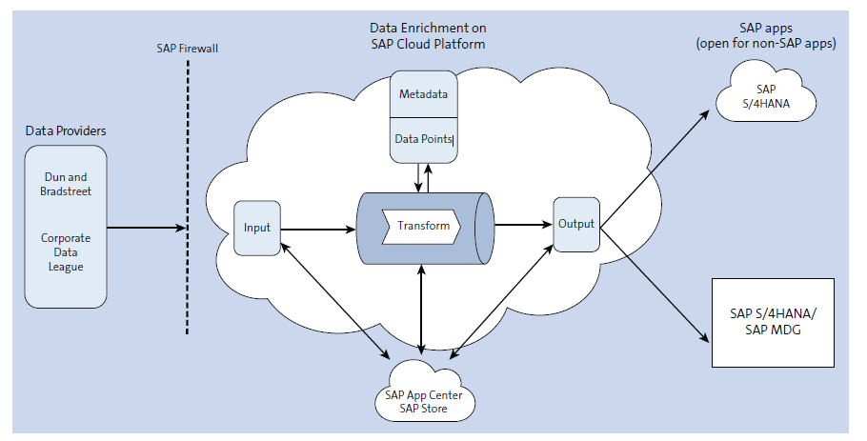
SAP S/4HANA cloud for data enrichment integration for external data
23
SAP MDG – Data Enrichment

Slide 11

End of Session23

Slide 12

Questions

Slide 13

Neeraj gupta

Slide 14


We’re committed to empower you to be
Most Desirable Resource
through powerful training solutions.
We build the workforce of the future.
250+
Corporate Clients
30,000+
Learners Trained
25000+
Learners Placed
FREE WEBINARS
Sign up for free webinars with industry experts every fortnight!
Enroll Now!
Contact us today!
https://anubhavtrainings.com/

Slide 15




More from AnubhavTrainings.com

